Slide 1
NextGen Airport Control System
Presenter Name :-
Vaibhav Gujarathi C229
Muzammil Khatik C243
Rohit Badgujar C264

Slide 2
AGENDA
Introduction
Schema
Attributes
ER Diagram
Relational Model
Constraints
Queries

Slide 3
Introduction
The Airport Management System (AMS) is a software application which aims to assist an airline with transactions related to making ticket reservations From the viewpoint of the airlines the system provides the following: -
The system should minimize repetitive work done by the system administrator and reservation clerks.
The system should maintain customer information in case of emergency.
The system should minimize the number of vacant seats on a flight and maximize flight capacity utilization.

Slide 4
ENTITIES
Passengers
Journey Details
Schedules
Flight Details
Ticket Details
Explore
5
Place 1
Place 2
Place 3
Place 4
All destinations

Slide 5
Introduction
Journey_id
Meal
Other info
Ticket_no
Journey id
Fair
Class
Status
Schedule id
Depar location
Arri location
Depar time
Arri time
Journey id
Flight no
Journey id
Schedule id
Passengers | JOURNEY DETAILS | TICKET DETAILS: | SCHEDULE: | FLIGHT DETAILS
P_id
First name
Last name
Passpor_no
P_age
E_mail
Residence
Phone_no
Relativephoneno.

Slide 6
Relationships & Cardinalities
1 Passenger books single ticket
1 flight can have many passengers
1 flight can have one journey
A single journey can be scheduled at once
Many tickets belongs to a flight
Many tickets can be generates during a scheduled flight

Slide 7
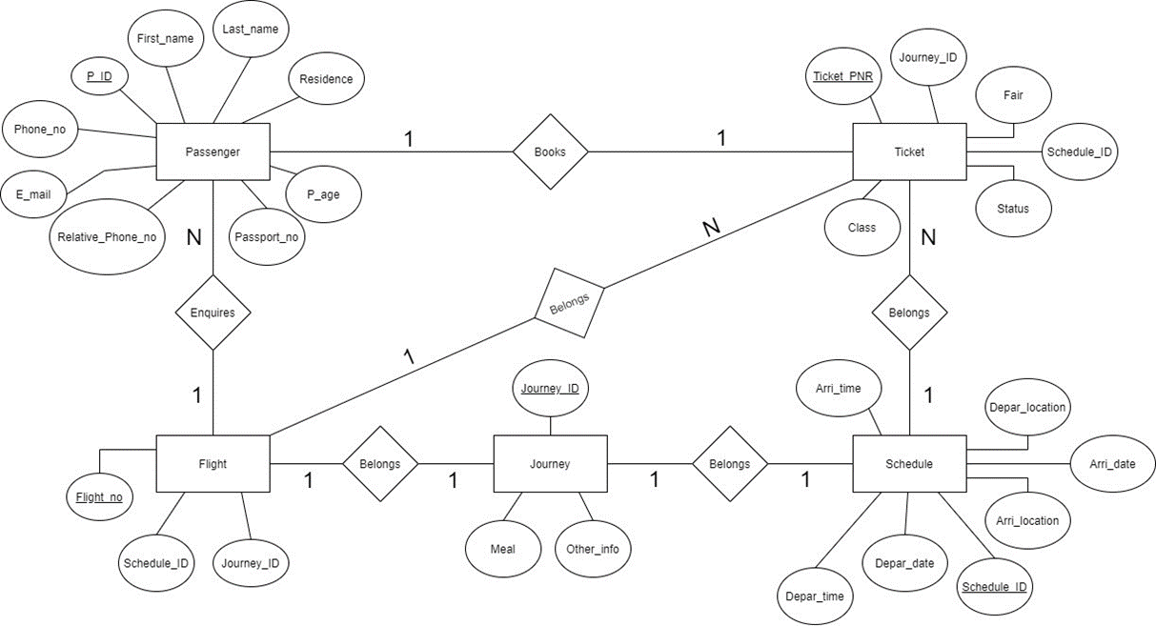
ER-DIAGRAM

Slide 8
ER-MODEL
Relation : Passenger & Ticket
P_ID
Ticket_pnr
First_name
Last_name
Residence
P_age
Passport_no
Phone_no
relative_phone_no
Email
Journey_ID
Fair
Schedule_Id
Realtion : Passenger & Flight
Passengers
P_ID
Flight_no
First_name
Last_name
Residence
P_age
Passport_no
Phone_no
relative_phone_no
Email
schedule_ID
Journey_id
Relation : Jorney & Schedule
Schedule
Journey_id
Schedule_Id
Meal
Other_info
Arri_time
Depar_time
Arri_date
Depar_date
Arri_location
Depar_location

Slide 9
ER-MODEL
Relation : Flight & Journey
Flight
Flight_no
Journey_id
schedule_ID
Journey_id
Meal
Other_info
Realtion : Ticket & Flight
Ticket
Ticket_pnr
Flight_no
Journey_ID
Fair
Schedule_Id
Status
Class
Meal
Other_info
Realtion : Schedule & Ticket
Ticket_pnr
Schedule_Id
Journey_ID
Fair
Schedule_Id
Status
Class
Arri_time
Depar_time
Arri_date
Depar_date
Arri_location
Depar_location

Slide 10
CONSTRAINTS
Constraints enforce limits to the data or type of data that can be inserted/updated/deleted from a table. The whole purpose of constraints is to maintain the data integrity during an update/delete/insert into a table.

Slide 11
COMMANDS
INSERT INTO Passenger
VALUES (6458972345,'Rohit','Badgujar',20,'Delhi',5674328896,6314895627,
'Rohit@gmail.com','D568749125','PNQ001');
INSERT INTO Passenger
VALUES (6458972346,'Vaibhav','Gujrathi',19,'Delhi',6314895627,2467831435, 'Vaibhav@gmail.com','E364785521','PNQ002');
INSERT INTO Passenger
VALUES(6458972347,'Muzammil','Khatik',20,'Jaipur',2467831596,9875546258,
'Muzammil@gmail.com’, 'F578942451','PNQ003');
INSERT INTO Passenger
VALUES (6458972348,'Shlok','Salunke',35,'Indore',6489521374,9865421374,
'Shlok@gmail.com','G246458713','PNQ004');

Slide 12
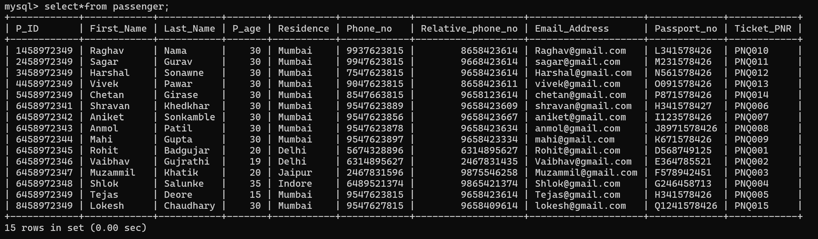
Passengers

Slide 13
COMMANDS
INSERT INTO Schedule
VALUES (201, 'Delhi', '2021-10-25', '06:30:00', 'Dubai', '2021-10-25','9:00:00');
INSERT INTO Schedule
VALUES (202, 'Dubai', '2021-10-26', '10:30:00', 'Delhi', '2021-10-25','12:00:00');
INSERT INTO Schedule
VALUES (203, 'Delhi', '2021-10-26', '06:30:00', 'New York','2021-10-27','2:00:00');
INSERT INTO Schedule
VALUES (204, 'New York', '2021-10-28', '12:30:00', 'Delhi','2021-10-29','14:00:00');
INSERT INTO Schedule
VALUES (205, 'Delhi', '2021-10-30', '15:30:00', 'Mumbai', '2021-10-30','17:00:00');

Slide 14
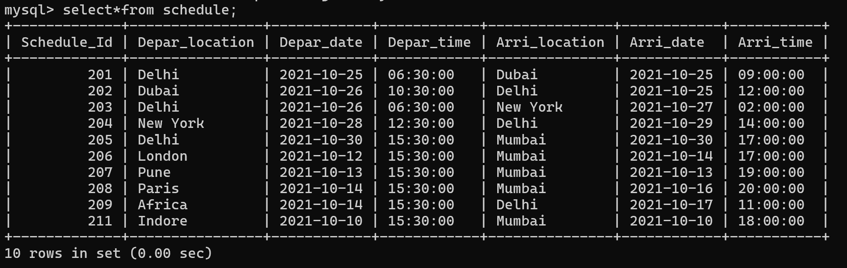
SCHEDULE

Slide 15
COMMANDS
INSERT INTO Journey
VALUES (513, 'YES', 'Require Wheelchair');
INSERT INTO Journey
VALUES (514, 'NO', NULL);
INSERT INTO Journey
VALUES (515, 'YES', 'Require Wheelchair');
INSERT INTO Journey
VALUES (516, 'NO', 'Require Wheelchair');
INSERT INTO Journey
VALUES (517, 'YES', NULL);

Slide 16

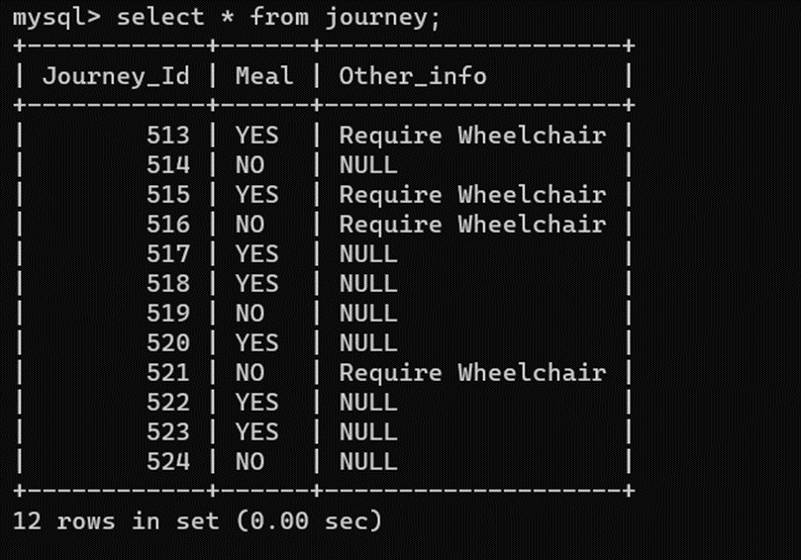
JOURNEY

Slide 17
COMMANDS
INSERT INTO Flight
VALUES ('AI407',201,513);
INSERT INTO Flight
VALUES ('AI408',202,514);
INSERT INTO Flight
VALUES ('AI409',203,516);
INSERT INTO Flight
VALUES ('AI410',204,517);
INSERT INTO Flight
VALUES ('AI411',205,518);

Slide 18
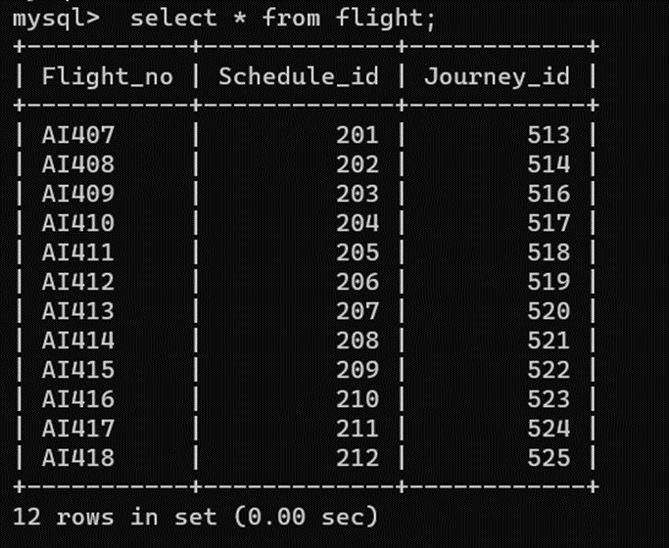
FLIGHTS

Slide 19
COMMANDS
INSERT INTO Ticket
VALUES ('PNQ001',513, 201, 25000,'ECONOMY','CONFIRMED');
INSERT INTO Ticket
VALUES ('PNQ002', 514, 202, 25000,'BUSINESS','CONFIRMED');
INSERT INTO Ticket
VALUES ('PNQ003', 513, 203, 85000,'FIRST','CONFIRMED');
INSERT INTO Ticket
VALUES ('PNQ004', 515, 204, 85000,'ECONOMY','NOT CONFIRMED');
INSERT INTO Ticket
VALUES ('PNQ005',517, 205, 12000,'BUSSINESS','CONFIRMED');

Slide 20
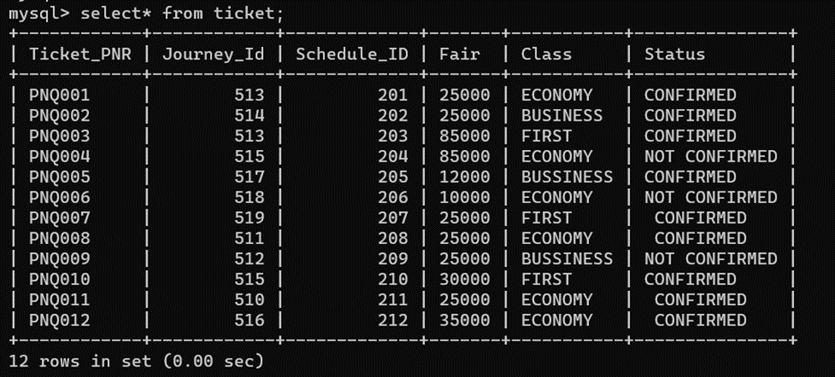
TICKETS

Slide 21
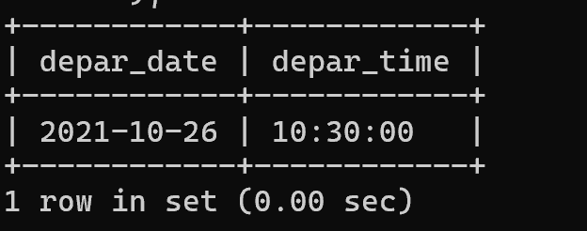
QUERIES
Find the departure time and date ofticket PNR = PNQ002. select depar_date, depar_time from schedule where schedule_id=(select schedule_id from ticket where ticket_PNR='PNQ002');
1

Slide 22
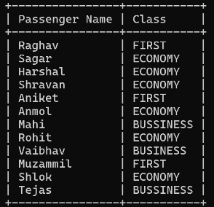
QUERIES
Show the passenger’s name along with the class in which they will travel. select passenger.First_Name as "Passenger Name", ticket.class as "Class" from ticket inner join passenger on passenger.Ticket_PNR=ticket.ticket_PNR;
2

Slide 23
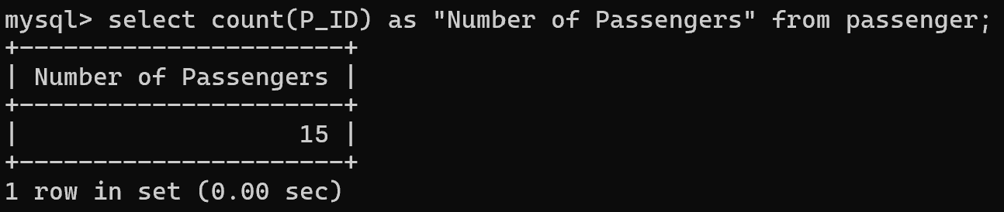
QUERIES
Find total number of passengers. select count(P_ID) as "Number of Passengers" from passenger;
3

Slide 24
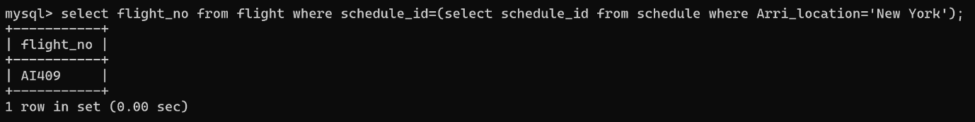
QUERIES
Find the flight number going to New York. select flight_no from flight where schedule_id=(select schedule_id from schedule where Arri_location='New York');
4

Slide 25
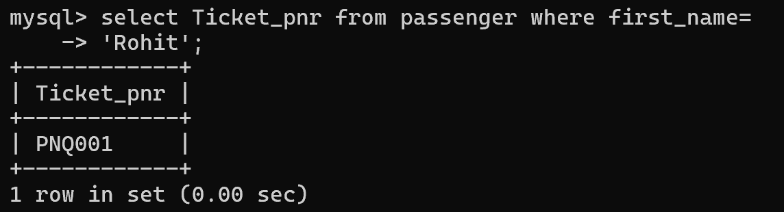
QUERIES
Find the ticket PNR of Raghav. select Ticket_pnr from passenger where first_name='Rohit';
5

Slide 26
SUMMARY
Airport Management database is collection and storing data related to Flight, Schedule & passenger . The data stored in database with the ease of retrieval, update and analyze whenever needed. Since Airport database differs from other database which includes timming,journey ,Ticket,etc.

Slide 27
THANK YOU

